Slide 1
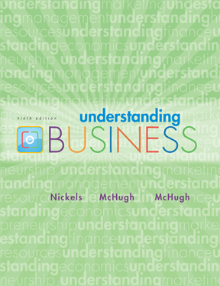
*
Chapter Seven
*
Management and Leadership
Tania Akter (TAK)
McGraw-Hill/Irwin
Copyright © 2010 by The McGraw-Hill Companies, Inc. All rights reserved.

Slide 2

RATIONAL DECISION-MAKING
MODEL (7D’s)
*
Decision Making: Finding the Best Alternative
*
LG3
    Define the situation.
    Describe and collect needed information.
    Develop alternatives.
    Develop agreement among those involved.
    Decide which alternative is best.
    Do what is indicated.
    Determine whether the decision was a good one and follow up.
7-<number>

Slide 3
1.Define the situation.
To make a decision, you must first identify the problem you need to solve or the question you need to answer. Clearly define your decision. If you misidentify the problem to solve, or if the problem you’ve chosen is too broad, you’ll knock the decision train off the track before it even leaves the station.

Slide 4
2. Describe and collect needed information
Once you have identified your decision, it’s time to gather the information relevant to that choice. Do an internal assessment, seeing where your organization has succeeded and failed in areas related to your decision. Also, seek information from external sources, including studies, market research, and, in some cases, evaluation from paid consultants.

Slide 5
3. Develop alternatives.
With relevant information now at your fingertips, identify possible solutions to your problem. There is usually more than one option to consider when trying to meet a goal—for example, if your company is trying to gain more engagement on social media, your alternatives could include paid social advertisements, a change in your organic social media strategy, or a combination of the two.

Slide 6
4. Develop agreement among those involved.
Once you have identified multiple alternatives, weigh the evidence for or against said alternatives. See what companies have done in the past to succeed in these areas, and take a good hard look at your own organization’s wins and losses. Identify potential pitfalls for each of your alternatives, and weigh those against the possible rewards.

Slide 7
5. Decide which alternative is best
Here is the part of the decision-making process where you, you know, make the decision. Hopefully, you’ve identified and clarified what decision needs to be made, gathered all relevant information, and developed and considered the potential paths to take. You are perfectly prepared to choose.

Slide 8
6. Do what is indicated.
Once you’ve made your decision, act on it! Develop a plan to make your decision tangible and achievable. Develop a project plan related to your decision, and then set the team loose on their tasks once the plan is in place.

Slide 9
7. Determine whether the decision was a good one and follow up
After a predetermined amount of time—which you defined in step one of the decision-making process—take an honest look back at your decision. Did you solve the problem? Did you answer the question? Did you meet your goals?
If so, take note of what worked for future reference. If not, learn from your mistakes as you begin the decision-making process again.

Slide 10

Problem Solving
*
Decision Making: Finding the Best Alternative
*
LG3
    Brainstorming –
    coming up with as many solutions possible in a short period of time with no censoring of ideas.
    Another technique is called PMI, or listing all the pluses for a solution in one column, all the minuses in another, and the implications in a third. The idea is to make sure the pluses exceed the minuses.
7-<number>

Slide 11
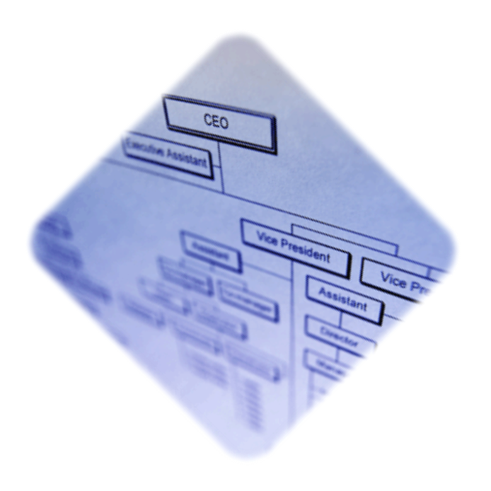
ORGANIZATIONAL CHARTS
*
Organizing: Creating a Unified System
*
LG4
Organization Chart -- A visual device that shows relationships among people and divides the organization’s work; it shows who reports to whom.
7-<number>

Slide 12
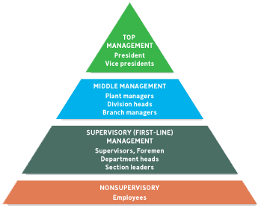
LEVELS of MANAGEMENT
*
Organizing: Creating a Unified System
*
LG4
7-<number>

Slide 13

Organizing
Skills/Tasks
  Technical- task in specific discipline
  Human relation- involve communication and motivation
  Conceptual- the ability to picture the org. as a whole
Staffing
  Involves recruiting, hiring, motivating and retaining the best people available to accomplish the company’s objectives.
7-<number>

